Slide 1





Slide 2


The Global Humanitarian Network
Bush Flying Webinar ​
September 25, 2023

Slide 3
Agenda
Time
10:00 - 10:05 | Welcome and Introductions
10:05 - 10:20 | Overview of Bush Air Operations Manual: Hank Conard
10:20 - 10:30 | Past, Present, and Future of Bush Flying: Elsa Klarich
10:30 - 10:35 | Wings of Hope Bush Pilot: Ed Schertz
10:35 – 11:15 | Missionary Bush Flying - Putting the Motto: "Accept Risks When Benefits Outweigh Costs" to Practice: Case Visser
11:15 - 11:20 | Scenario Based Discussion
11:20 - 11:25 | Recap of Key Takeaways, Next Steps
11:25 - 11:30 | Thank You/Closing

Slide 4
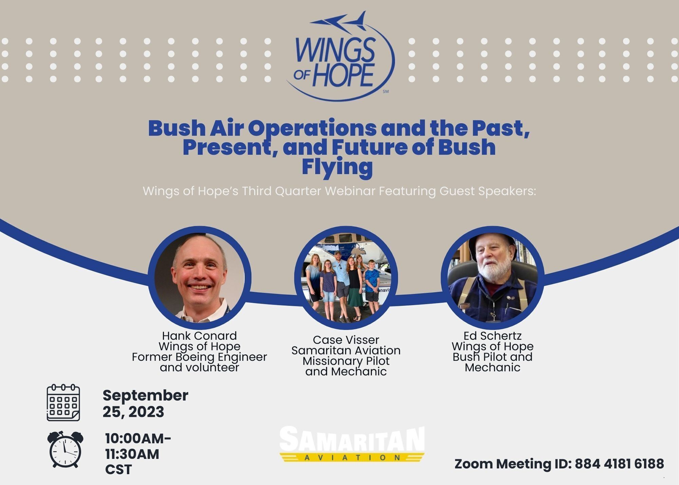

Slide 5
Overview
Wings of Hope Bush Air Operations Manual
Missionary Bush Flying in Papua New Guinea
The Reason for Bush Flying
Bush Flying Definition and Safety
Wellbeing for Bush Flying Personnel

Slide 6
Intro to the GHN Web Portal
Wings of Hope is in the process of developing a website portal which will house aviation information including a Bush Flying and UAS Toolkit including Program Planning Templates. This will offer the GHN members access to further their Bush Flying Operation initiatives and provide UAS planning information for future drone initiatives. Wings of Hope desires that all partners have access to more:
Bush Flying Information and Manuals
2. UAS Development Processes
3. Community within the GHN

Slide 7

Bush Air Operations Manual
Hank Conard
Wings of Hope Volunteer
September 2023

Slide 8
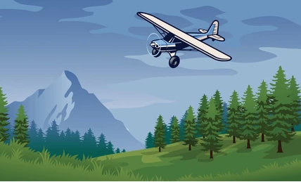
The Mission
Provide a guide to Wings of Hope partners throughout the world looking to provide humanitarian support via a bush air service.

Slide 9
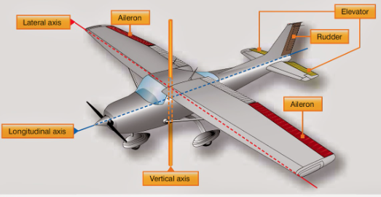
The Method
Utilize a concept of operations model to identify the humanitarian needs as well as the resources, timelines, plans, and risks to meet those needs.
Make the document as brief as possible while providing extensive appendix links to allow partners to drill down on specific topics of interest.
Create a “gap document” to get those with less technical savvy up to speed on aviation basics.

Slide 10
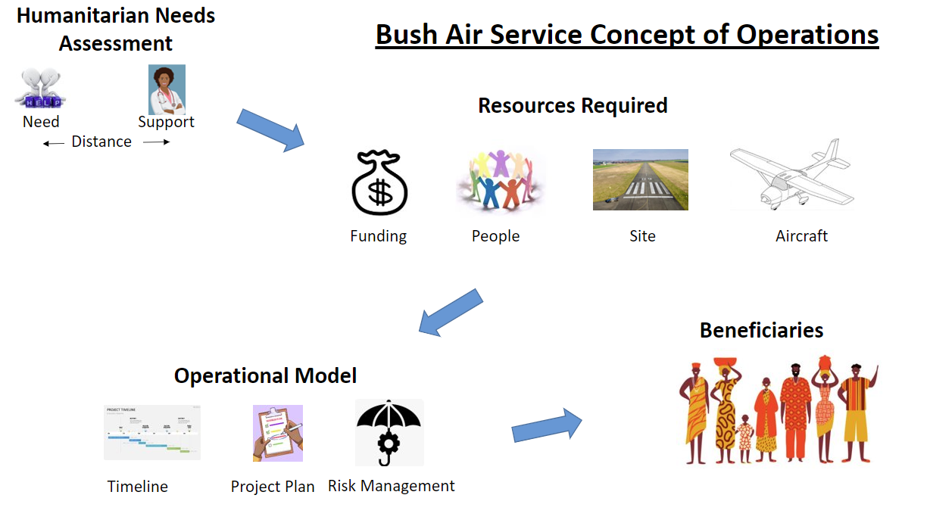
What is Humanitarian Support?

Slide 11
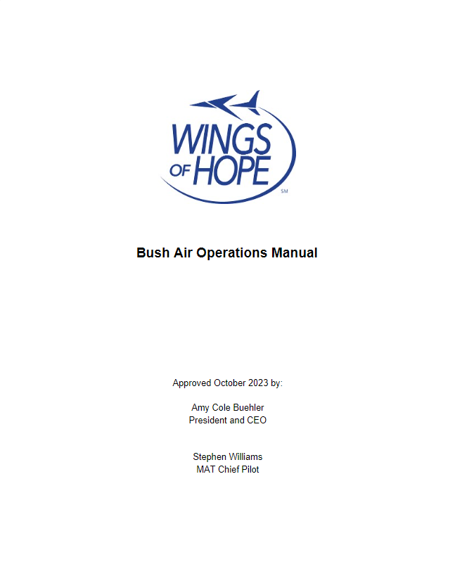
The Documents
Bush Air Operations Manual
27 Pages

Slide 12
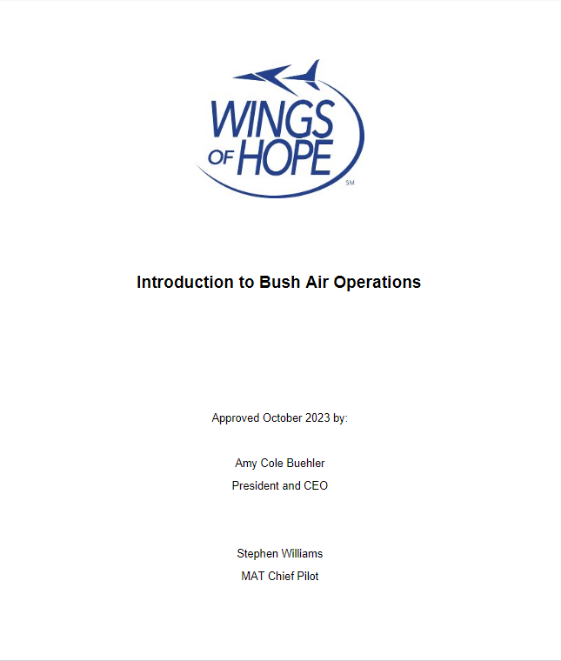
The Documents
Introduction to Bush Air Operations
9 Pages

Slide 13
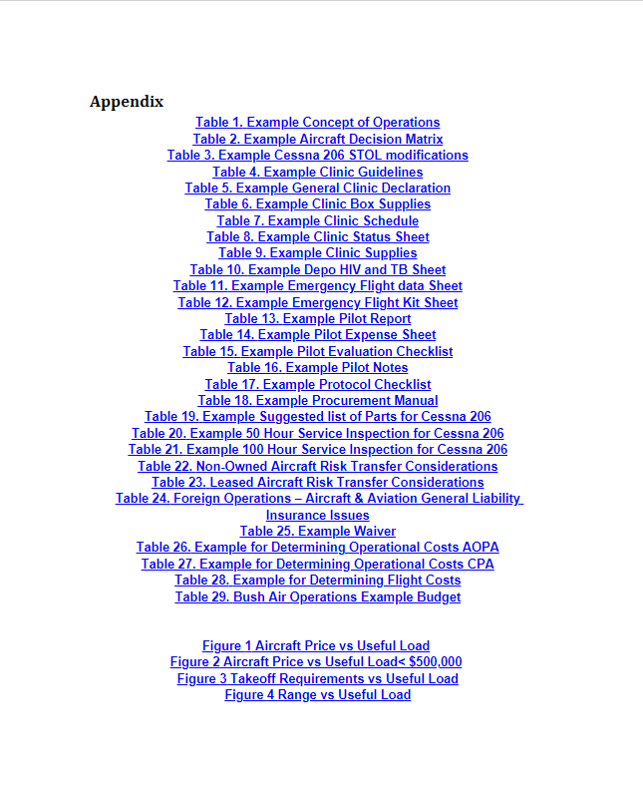
The Documents
Appendix/Documents List
100 Pages

Slide 14
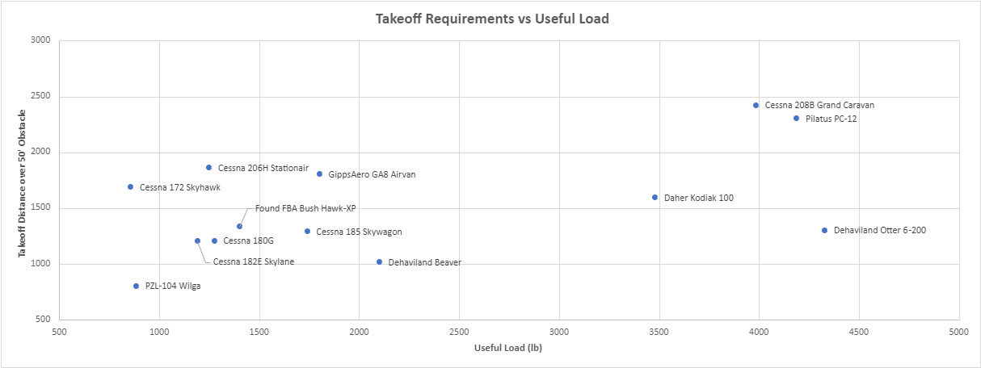
Some of the Details

Slide 15
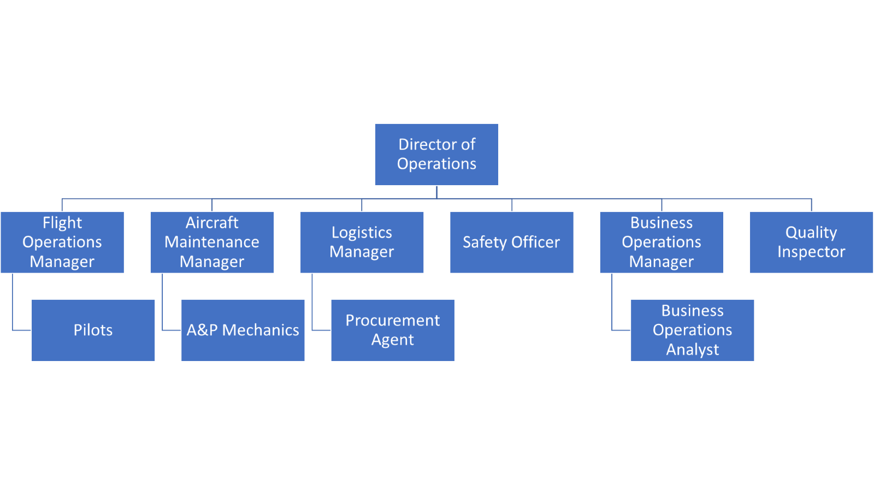
The Documents
Organizational Chart

Slide 16
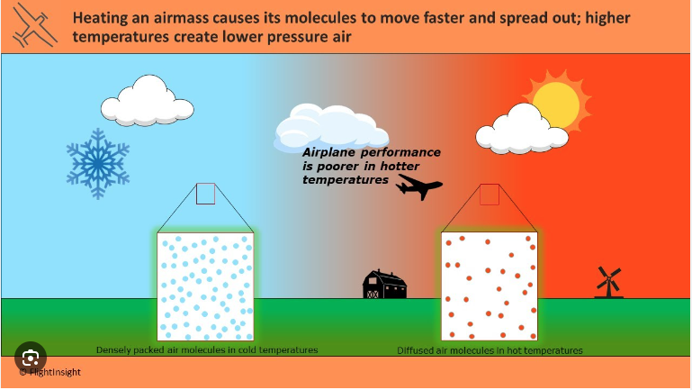

Slide 17
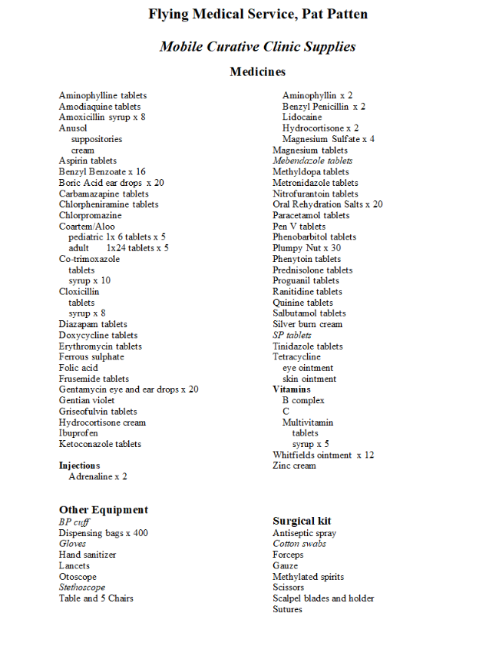
The Documents
Medical Supply List

Slide 18
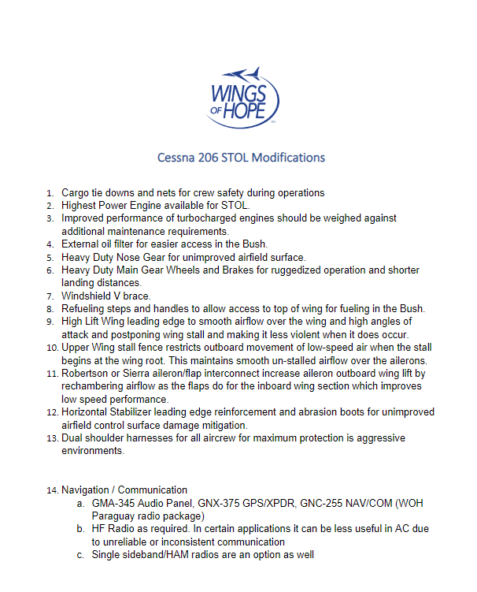
The Documents
STOL Modifications

Slide 19
Example Bush Air Operations Annual Budget
Item | Description | Year 1 | Year 2 | Year 3 | Year 4 | Year 5 | Year 6 | Year 7 | Year 8 | Year 9 | Year 10 | Total | Breakdown | Per AC Hour | % Cost
Aircraft |  |  |  |  |  |  |  |  |  |  |  |  | $1,652,147 | $367 | 40%
Down Payment | Put 50% down on used 206H | $176,500 |  |  |  |  |  |  |  |  |  | $176,500
Loan | Annual Cost of 206H 10 yr loan @5% | $22,465 | $22,465 | $22,465 | $22,465 | $22,465 | $22,465 | $22,465 | $22,465 | $22,465 | $22,465 | $224,647
Fuel | 450 annual hours @ 13 gal/hr x $6/gal | $35,100 | $35,100 | $35,100 | $35,100 | $35,100 | $35,100 | $35,100 | $35,100 | $35,100 | $35,100 | $351,000
Maintenance Costs | Inspection, annuals, mantenance | $90,000 | $90,000 | $90,000 | $90,000 | $90,000 | $90,000 | $90,000 | $90,000 | $90,000 | $90,000 | $900,000
Staff |  |  |  |  |  |  |  |  |  |  |  |  | $1,350,000 | $300 | 32%
Director of Operations | $45,000/year Salary | $45,000 | $45,000 | $45,000 | $45,000 | $45,000 | $45,000 | $45,000 | $45,000 | $45,000 | $45,000 | $450,000
Pilot 1 | $45,000/year Salary | $45,000 | $45,000 | $45,000 | $45,000 | $45,000 | $45,000 | $45,000 | $45,000 | $45,000 | $45,000 | $450,000
Pilot 2 | $45,000/year Salary | $45,000 | $45,000 | $45,000 | $45,000 | $45,000 | $45,000 | $45,000 | $45,000 | $45,000 | $45,000 | $450,000
Other |  |  |  |  |  |  |  |  |  |  |  |  | $340,000 | $76 | 8%
Facility Costs | $1000/month | $12,000 | $12,000 | $12,000 | $12,000 | $12,000 | $12,000 | $12,000 | $12,000 | $12,000 | $12,000 | $120,000
Insurance Costs | $10,000/year for facility and AC | $10,000 | $10,000 | $10,000 | $10,000 | $10,000 | $10,000 | $10,000 | $10,000 | $10,000 | $10,000 | $100,000
Medical Supplies | $1000/month | $12,000 | $12,000 | $12,000 | $12,000 | $12,000 | $12,000 | $12,000 | $12,000 | $12,000 | $12,000 | $120,000
Risk Mitigation | 25% of total costs for unforseen events | $123,266 | $79,141 | $79,141 | $79,141 | $79,141 | $79,141 | $79,141 | $79,141 | $79,141 | $79,141 | $835,537 | $835,537 | $186 | 20%
Total |  | $616,331 | $395,706 | $395,706 | $395,706 | $395,706 | $395,706 | $395,706 | $395,706 | $395,706 | $395,706 | $4,177,683 | $4,177,683 | $928 | 100%

Slide 20

The Result
Based on extensive consultations from subject matter experts with decades of experience conducting these missions, we have created a user-friendly comprehensive collection of documents that greatly increases the likelihood of success for those who seek to provide humanitarian support via a bush air operation.

Slide 21



Slide 22
Bush Air Operations and the Past, Present, and Future of Bush Flying

Slide 23
A Definition of "Bush Flying"
"A bush pilot is a person who is able to fly a light to medium size aircraft safely in and out of places that would normally be regarded by most other pilots as "marginal", "too dangerous" or "impossible".
-Milne "CC" Pocock -Bush Air -South Africa and USA

Slide 24
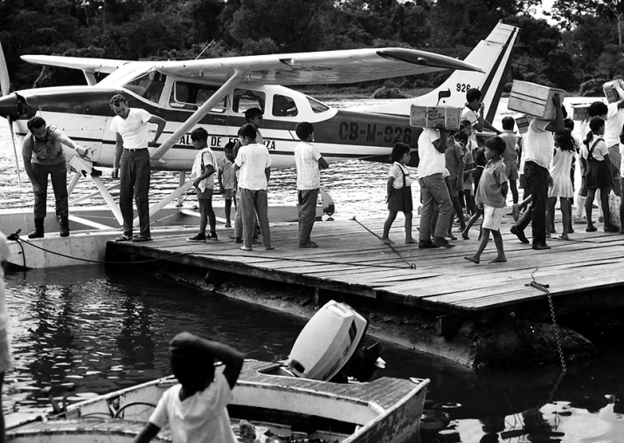
The Past
The bush, the backcountry, the outback, the wilderness, the wilds
Flying in the bush requires pilots to have experience and confidence
Airplanes need to be able to handle the abuse and be able to bounce back from encounters with rocks and branches
Early airplanes were too fragile to be put to use on rough strips, but by the 1920’s, the equipment, from airframes to powerplants, had improved significantly
Skis and floats came along with new models of planes designed for inhospitable terrain
Bush flying remains a critical part of the world’s transportation infrastructure, linking remote locations with goods, services and care, and in the process saving countless lives

Slide 25
The Present
Modern bush planes incorporate advanced avionics systems and powerful, fuel-efficient engines, STOL, tires etc.
Allows for smoother and safer operation
More efficient and effective in remote regions
More frequent radio calls
Safer training techniques and opportunities

Slide 26
The Future
Improving Safety Standards and Reducing Carbon Emissions
Navigation systems and engine efficiency innovations
Flying electric batteries
Evolution to improve safety standards and reduce carbon emissions
Delivering essential services safely
Reducing human error factors while deploying time-critical help whenever needed
Saving thousands of lives during emergencies caused by natural disasters, medical emergencies, and deliveries of supplies

Slide 27
Bush Flying Safety
"The life and death nature of bush flying also means that bush pilots frequently resort to untested methods for accomplishing the job, the result is that many common practices are pioneered in bush flying."

Slide 28
Bush Flying Operations and Wellbeing
Pilots need to assess their own wellbeing and make it part of their preparation
Monitor performance. Pilots need to make an accurate judgement on physical and mental health. Research around depression has improved the treatment options. Medications today have proved successful in effecting a safe and stable recovery
Awareness:
Wellness post-trauma/tragedy/bad experience
Alcohol and other drugs
Diet
Hydration
Fatigue
IMSAFE checklist

Slide 30


Slide 32

Missionary Bush Flying
Putting the Motto:
  “Accept Risk When Benefits Outweigh the Costs”
  to Practice.

Slide 33
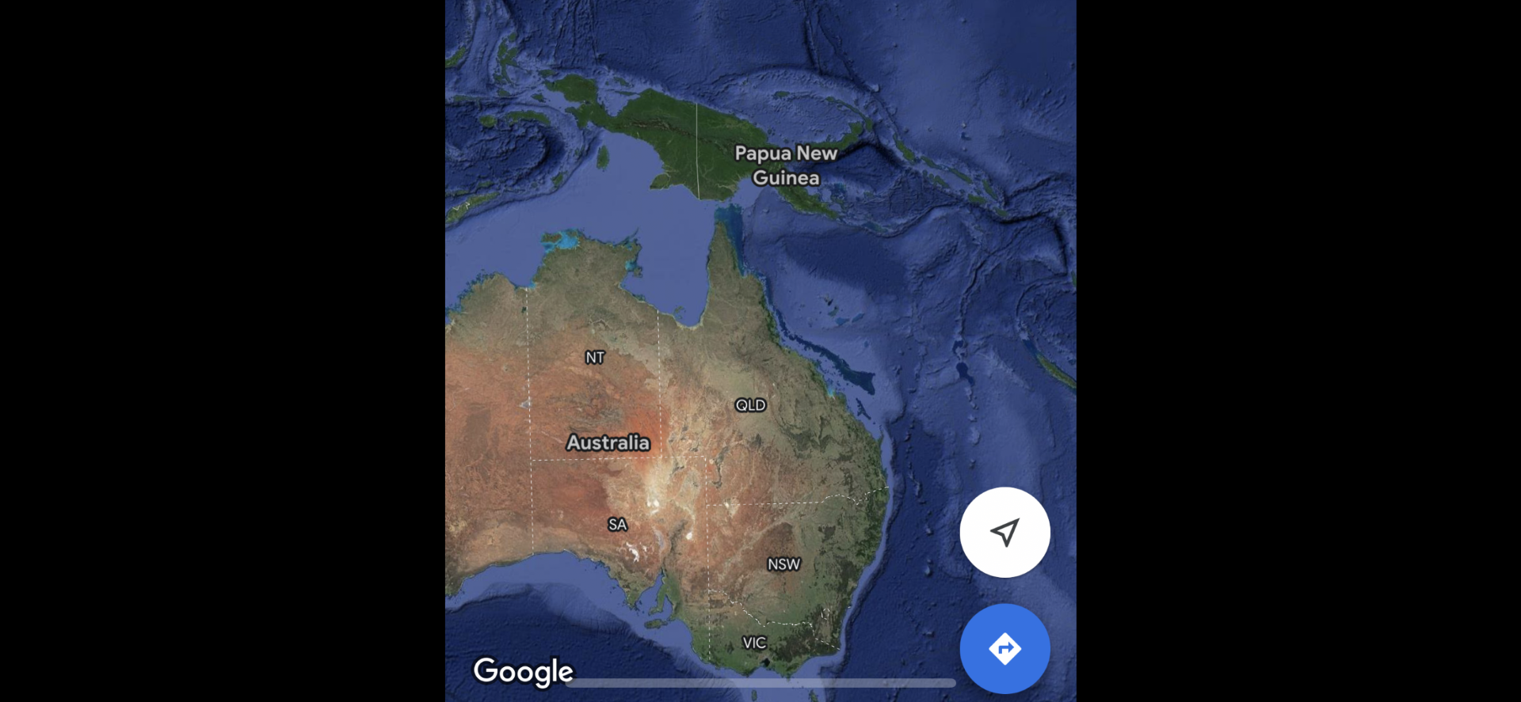

Slide 34
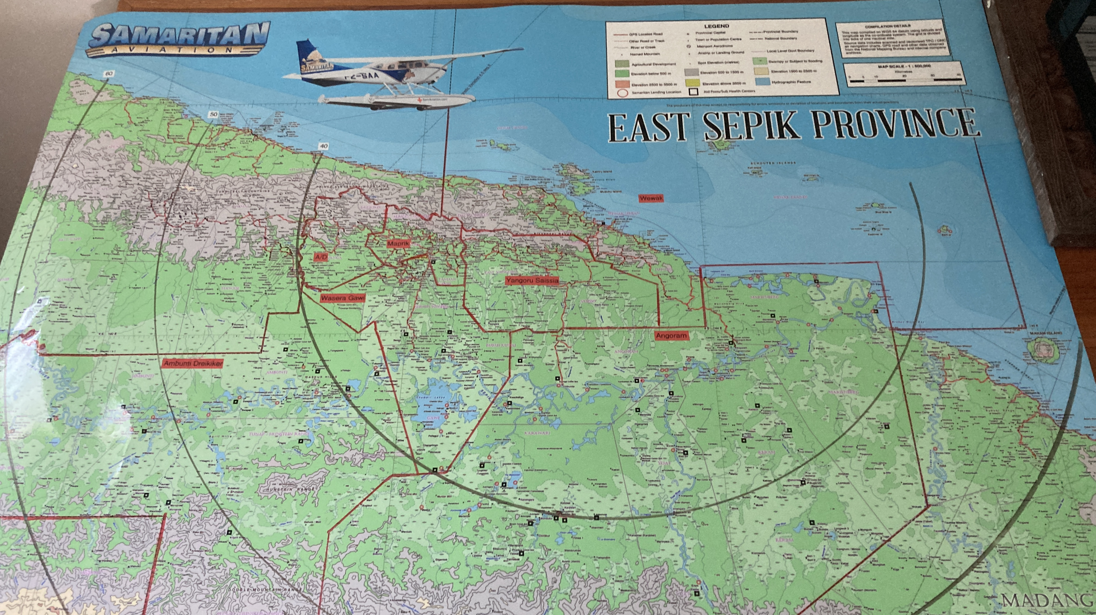

Slide 35
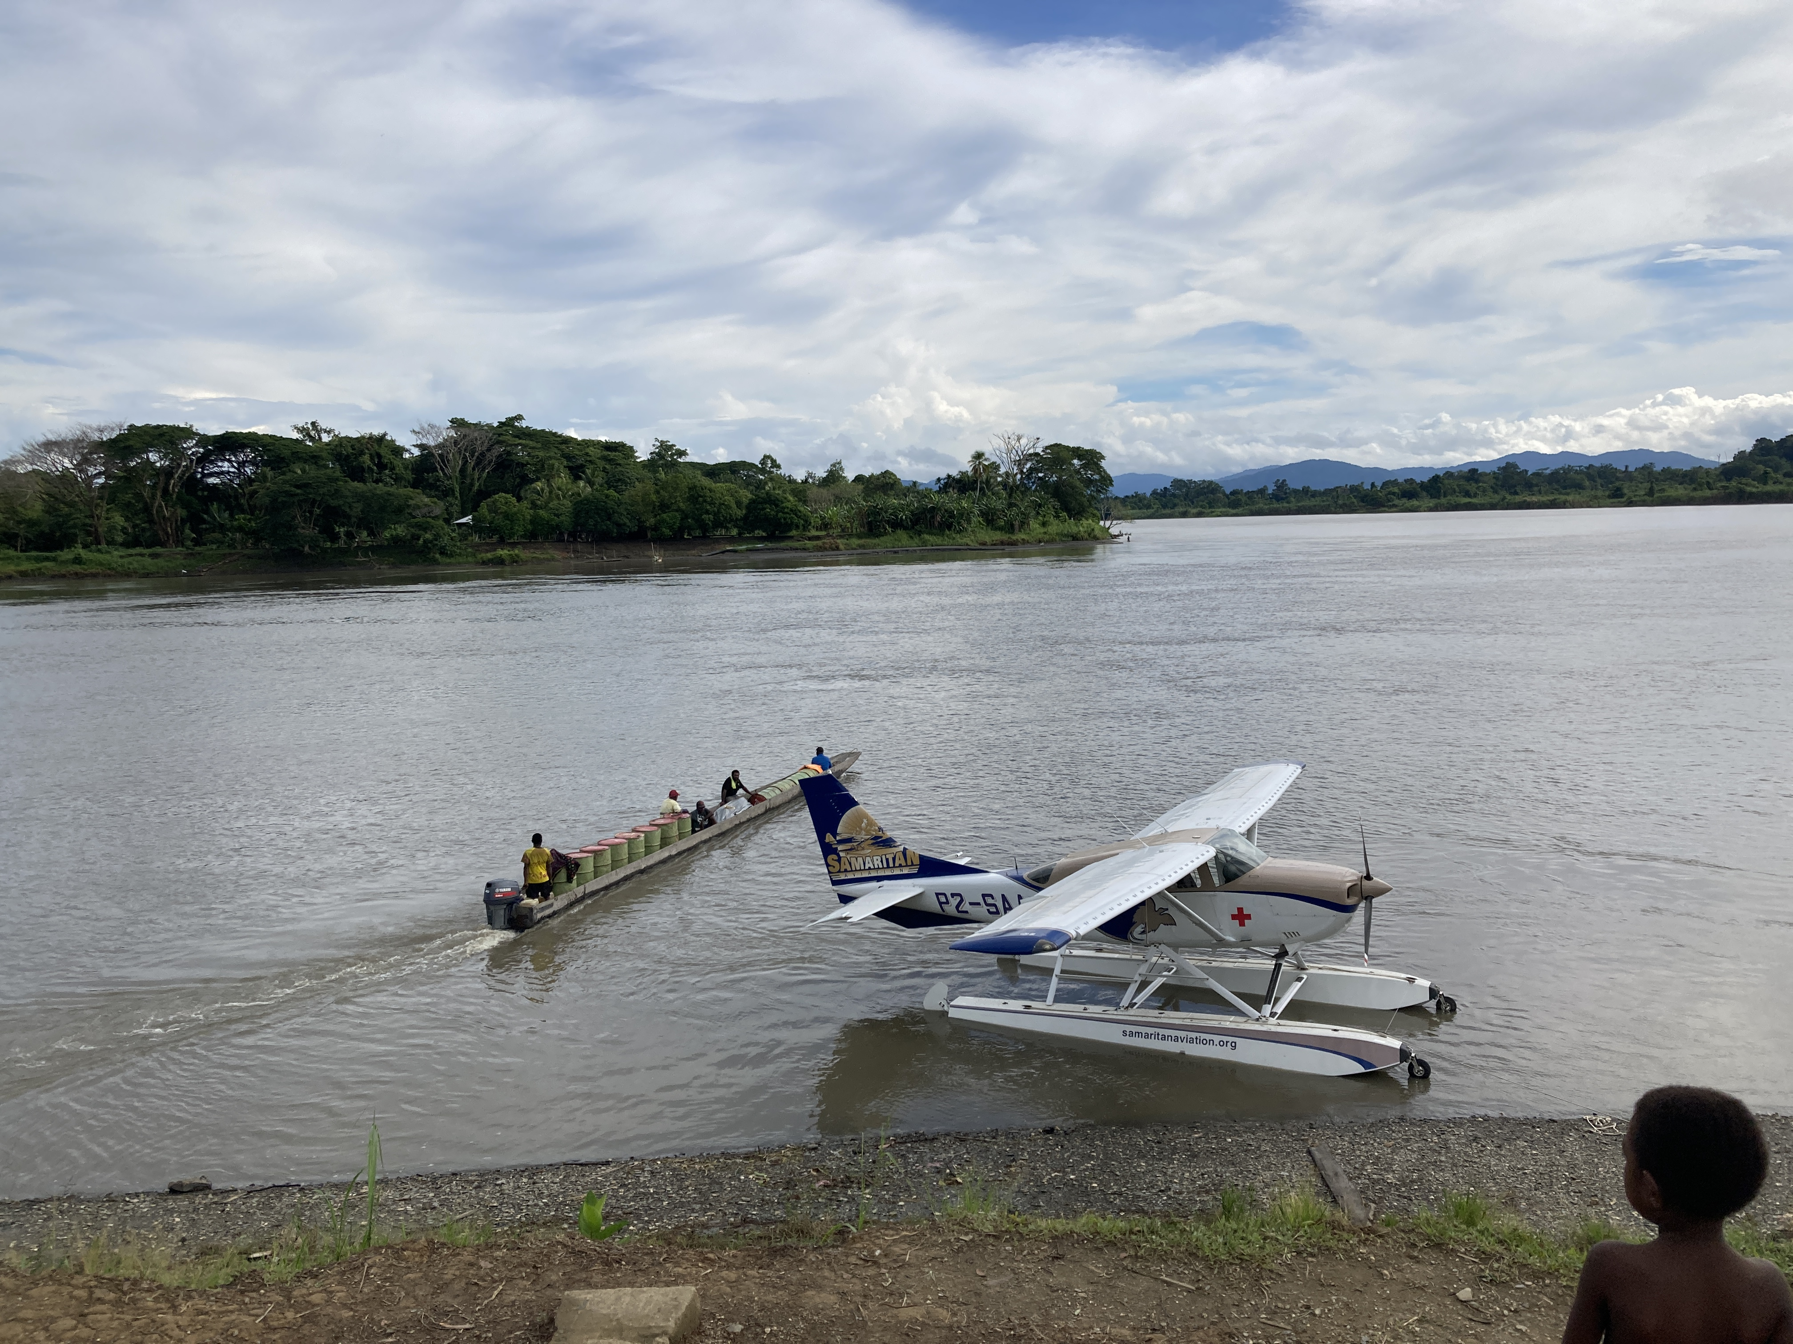

Slide 36
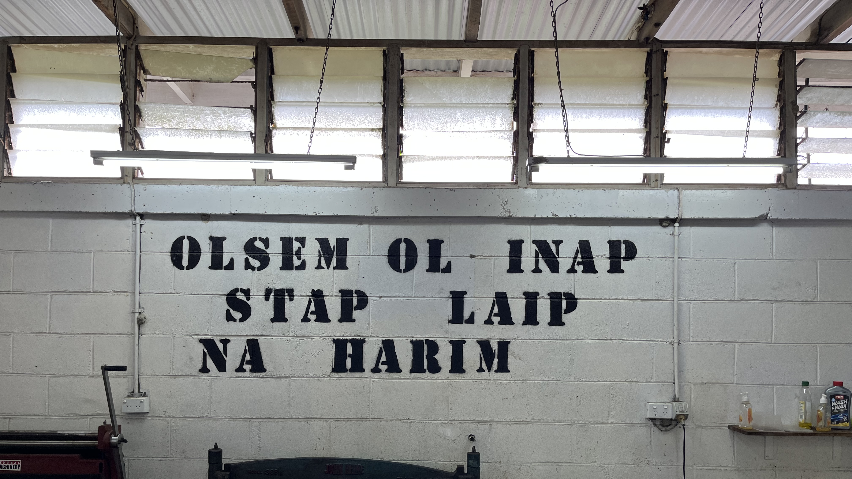

Slide 37
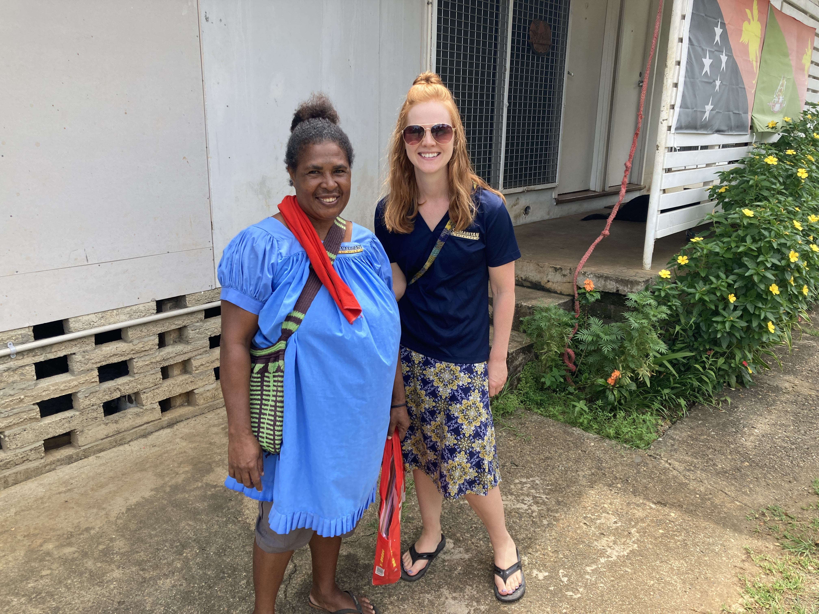

Slide 38
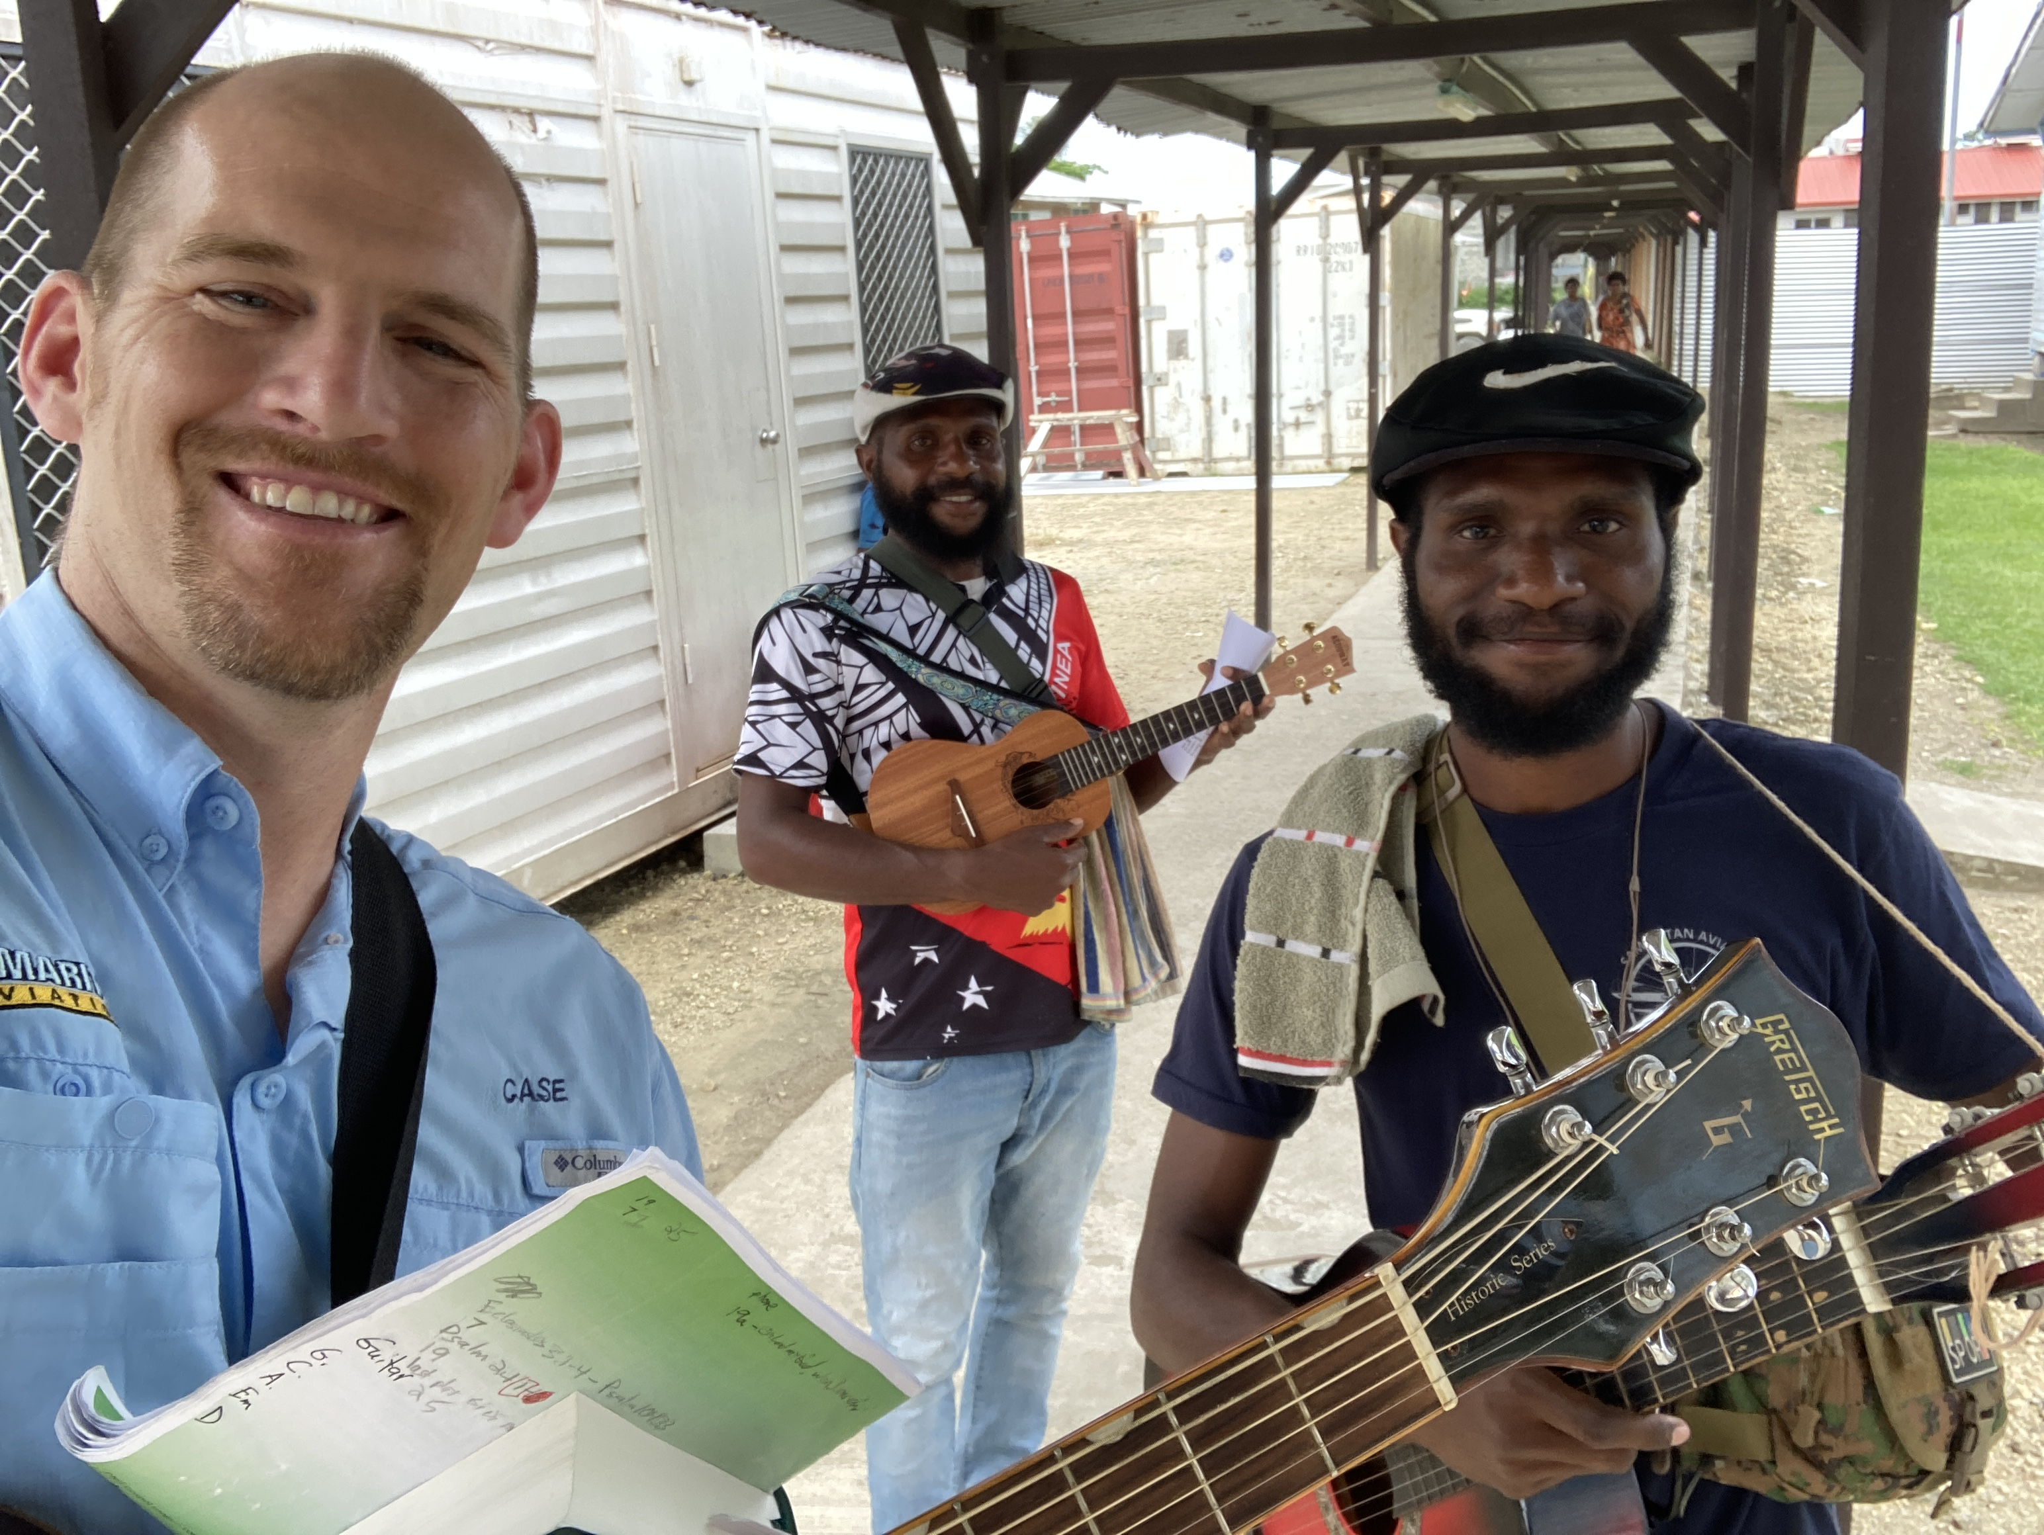

Slide 39
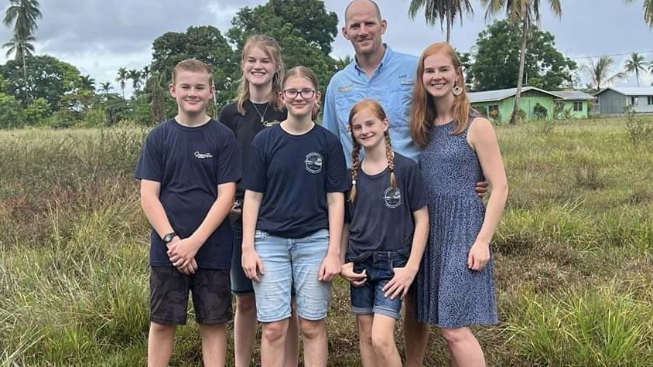

Slide 40
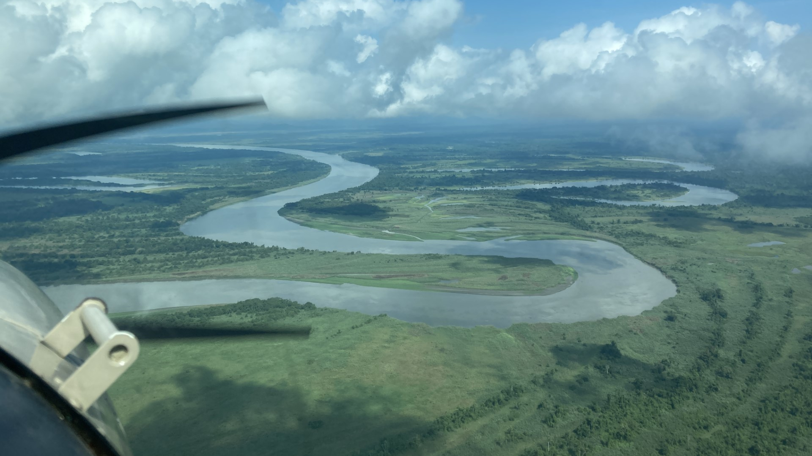

Slide 41
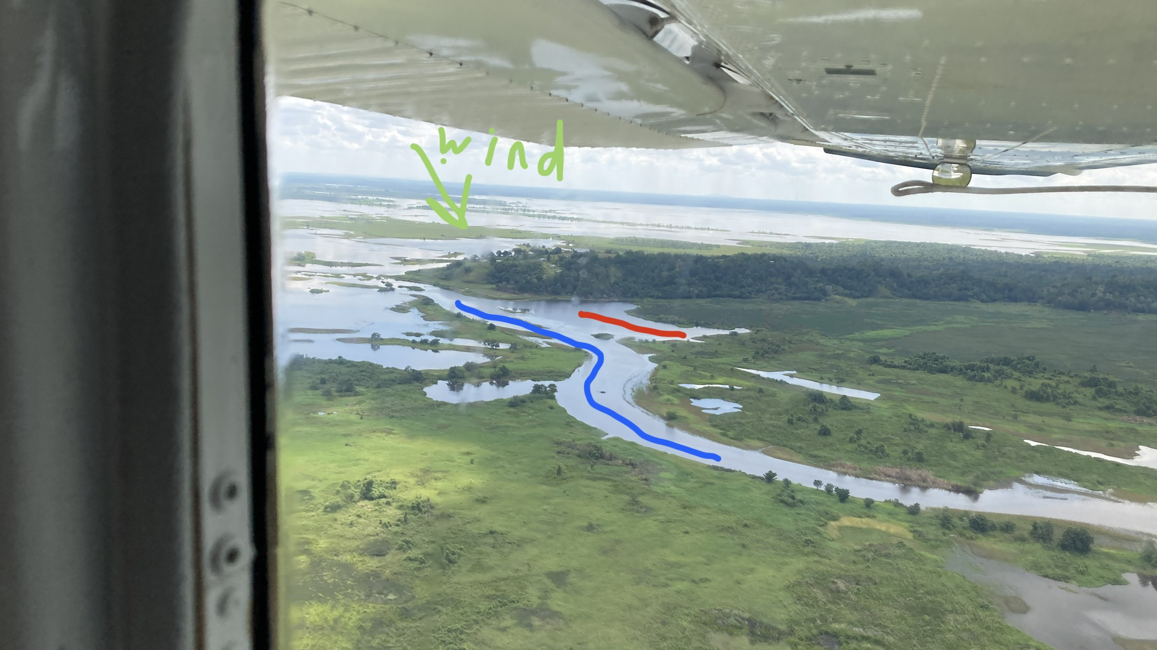

Slide 42
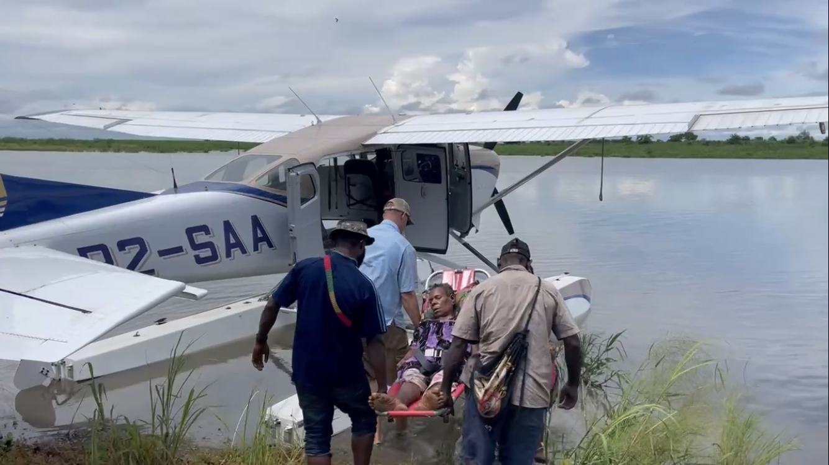

Slide 43
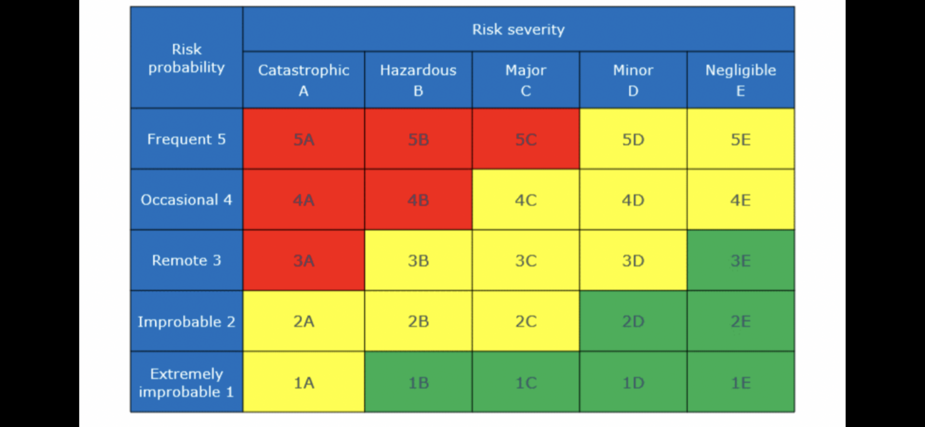

Slide 44


Slide 46
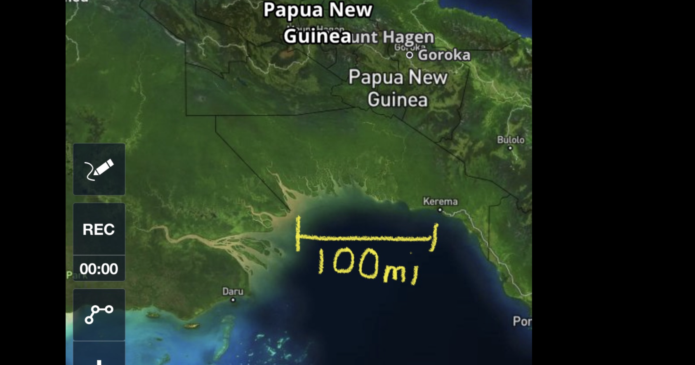

Slide 47


Slide 48
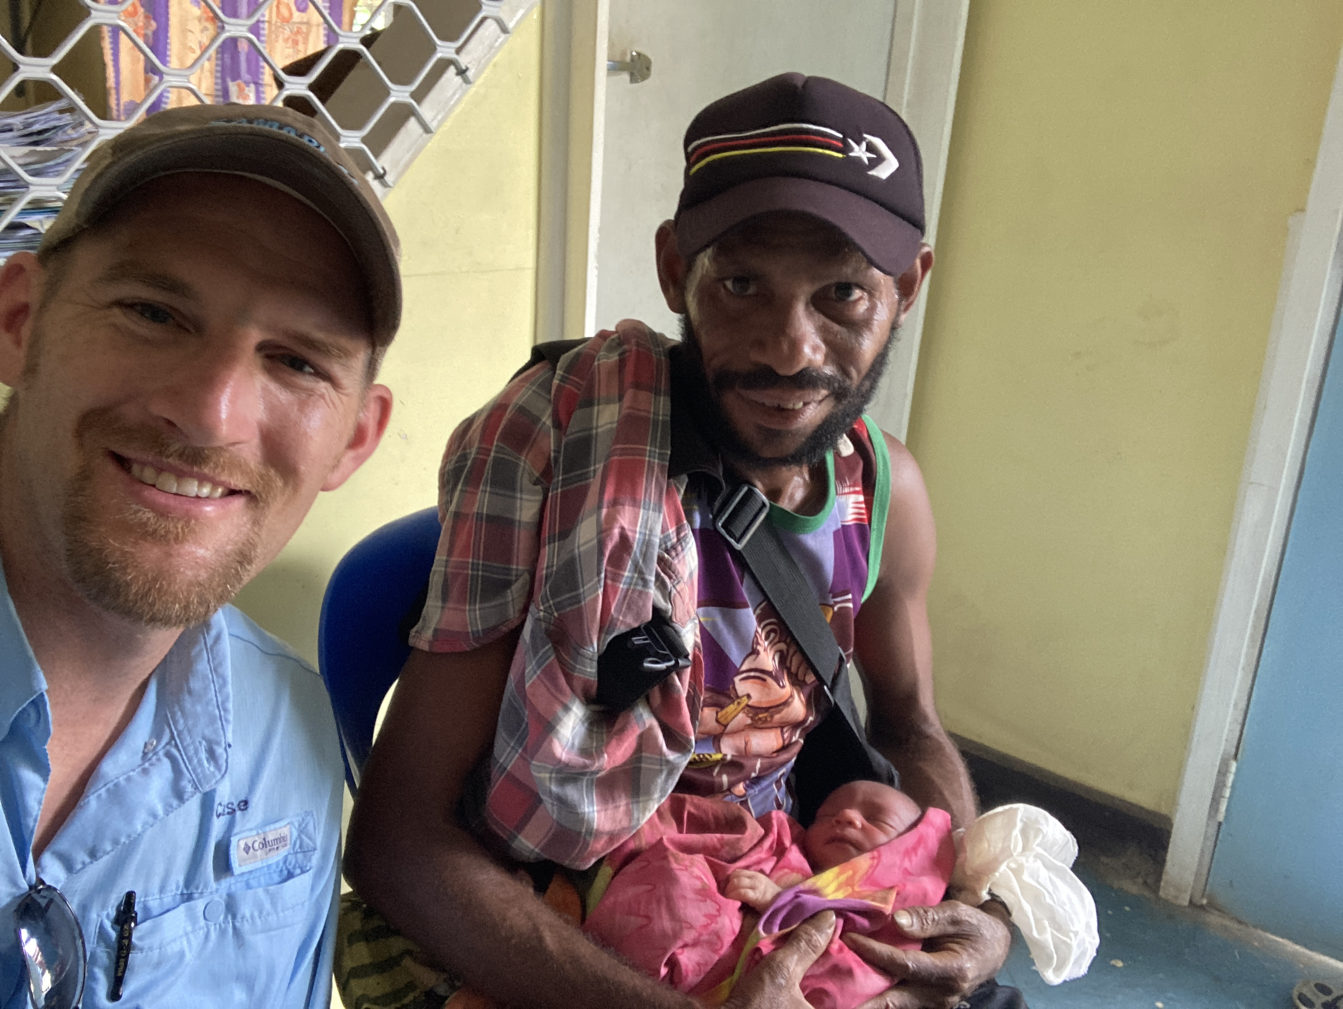

Slide 49
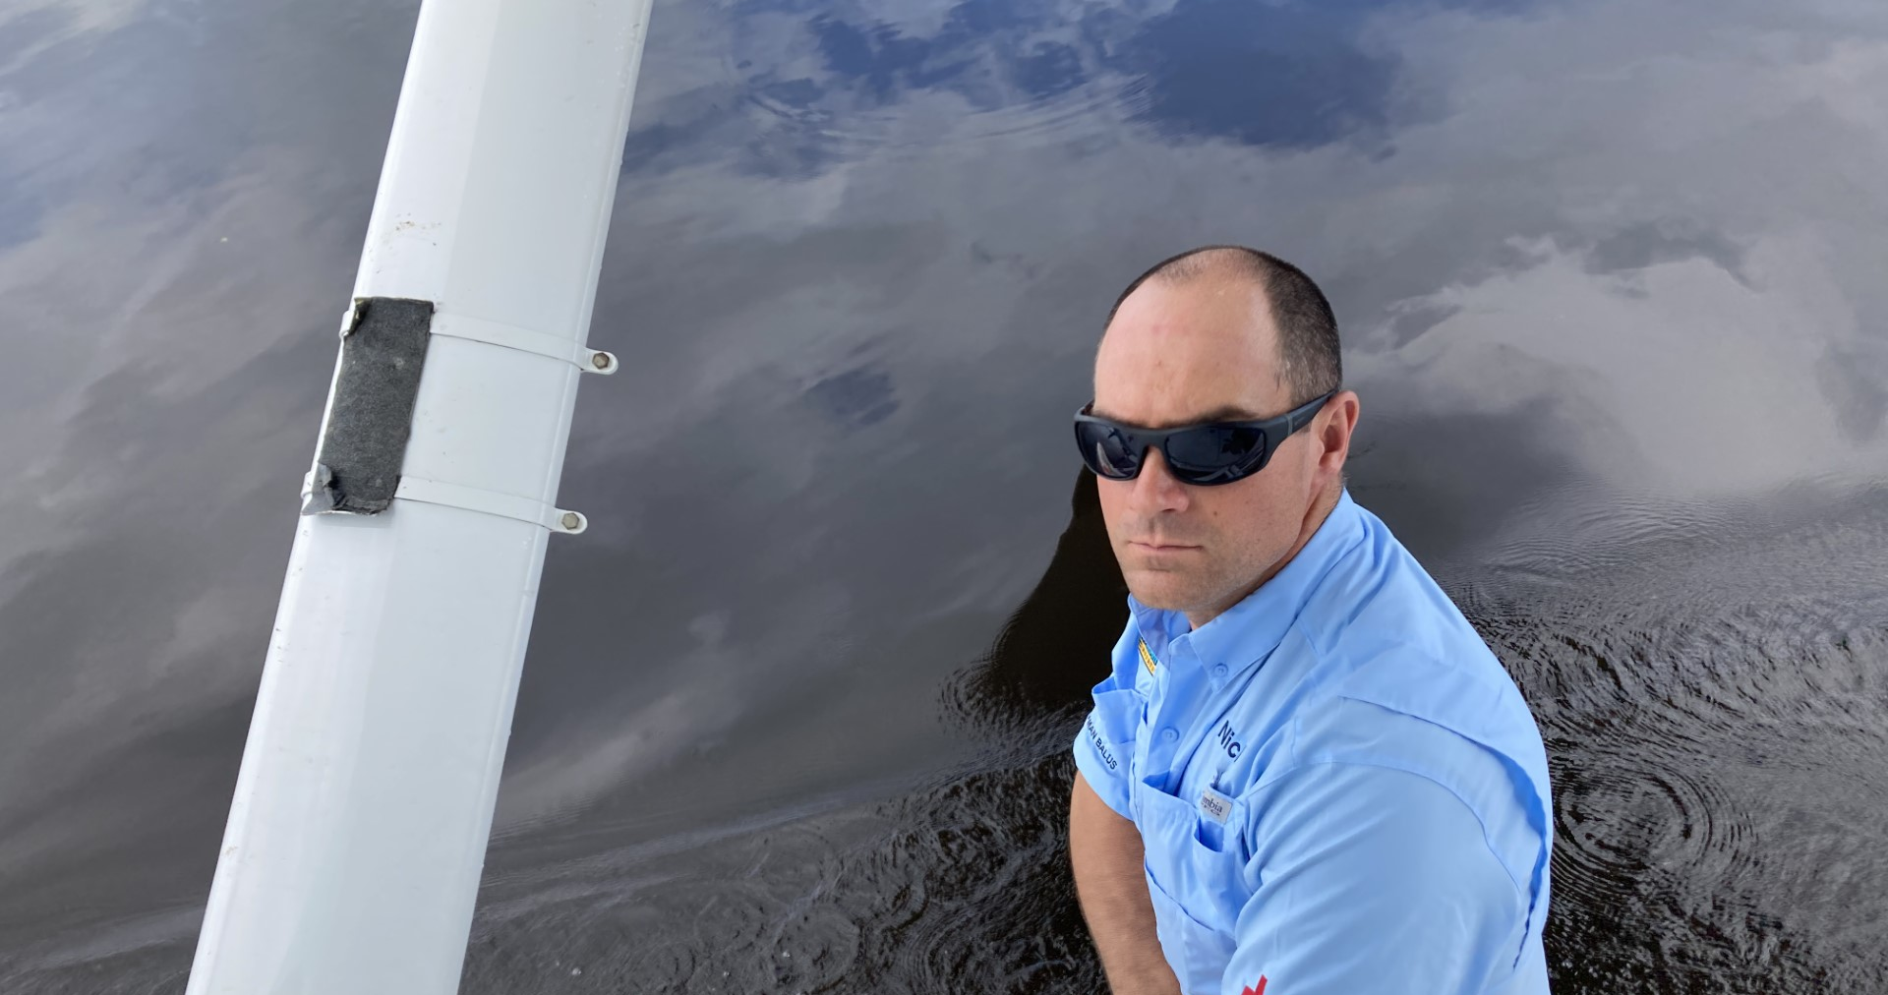

Slide 50
Scenario Based Discussion:
Discuss what you would like to do or already do to help support the wellbeing of your pilots:
1. What are your initial thoughts regarding the sustainability of wellbeing and safety?
2. What would you do or would you like to do to help your pilot/personnel after a traumatic event? (Professional or Personal)
3. How does your organization ensure a sense of wellbeing and safety to promote safety culture?
4. How can Wings of Hope help support your organization in safety, wellness, and wellbeing?

Slide 51
Key Takeaways
GHN Resources
The Future of Safety in Bush Flying
Health, Wellbeing, and Wellness in Bush Operations

Slide 52
Reminders
Last quarterly webinar
  Administrative Procedures and Best Practices
    The webinar will address
      Essential administrative matters and best practices, which can encompass topics like intellectual property agreements, online portals, and organizational goals
        November 13, 2023, 10:00am CST

Slide 53
Resource Links
https://bush-air.com/bushflying-intro.htm
https://www.planeandpilotmag.com/news/pilot-talk/plane-facts-bush-planes/
https://flyaroundalaska.com/bush-pilot/fly-around-alaska-flight-school-bush-planes-remote-regions/
https://www.businessinsider.com/why-alaska-bush-pilots-are-essential-in-the-state-2022-1?r=US&IR=T
http://ebushpilot.com/bpc-intro.htm
https://www.casa.gov.au/resources-and-education/education-and-training/out-n-back/episode-24-pilot-wellbeing#Physicalhealth

